Slide 1
LIVING OFF CAMPUS & THE TRANSFER EXPERIENCE with Contemporary Student Services

Slide 2
TODAY’S AGENDA
Getting Connected
Searching for Off-Campus Housing
Off-Campus Advisors
Questions

Slide 3
THE BASICS
KNOW YOUR RESOURCES
MAKE CONNECTIONS
GET ENGAGED
ULIFE.GMU.EDU

Slide 4
FOR TRANSFER STUDENTS
Vice President’s Transfer Advisory Board (TSAB)
Transfer Student Meetups
National Transfer Student Week
Transfer Nation

Slide 5


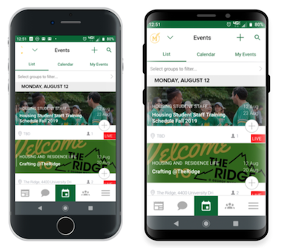
Find social and educational events and activities
Filter by “Transfer Events,” “Family Friendly, “Online,” and so much more
There are over 400 clubs and student organizations

Slide 6
SEARCHING FOR HOUSING

Slide 7
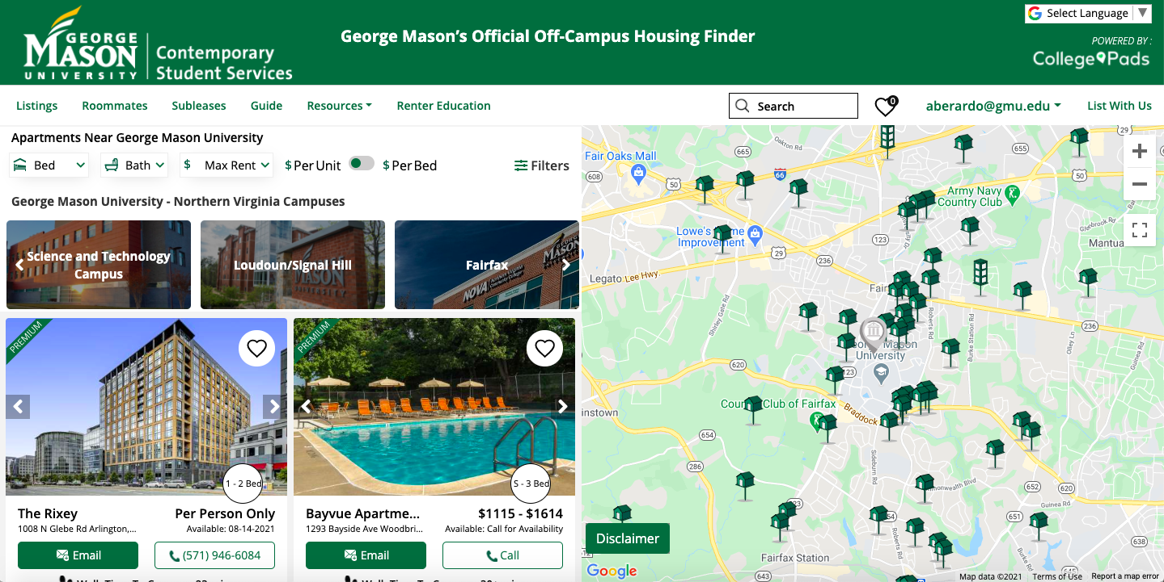
START YOUR SEARCH
och.gmu.edu

Slide 8
SEARCHING FOR PROPERTIES
On this page you can use filters to narrow your search and click on property cards to learn more.

Slide 9
OTHER CONSIDERATIONS FOR OFF-CAMPUS STUDENTS
Transportation
Mason has many free and low-cost transportation options:
Mason Shuttles:
Metro to Mason
Burke Centre VRE
Fairfax-SciTech
Gunston Go-Bus
West Campus
Zimride (Mason's rideshare program)
CUE Bus (free with Mason ID)
Bicycles
Carpool Lanes
Visit transportation.gmu.edu
Parking
Students are required to have a parking pass if they drive to campus. Parking passes go on sale in late July
Student Services
Off-campus students have access to the same student services as on-campus students, including recreation facilities, Student Health Services, Counseling and Psychological Services, dining services, Athletics, and many more
Time management
With a commute to campus and other responsibilities that residential students might not have, it is important to practice great time management to make sure you are able to get to class on time and maintain great well-being practices!

Slide 10
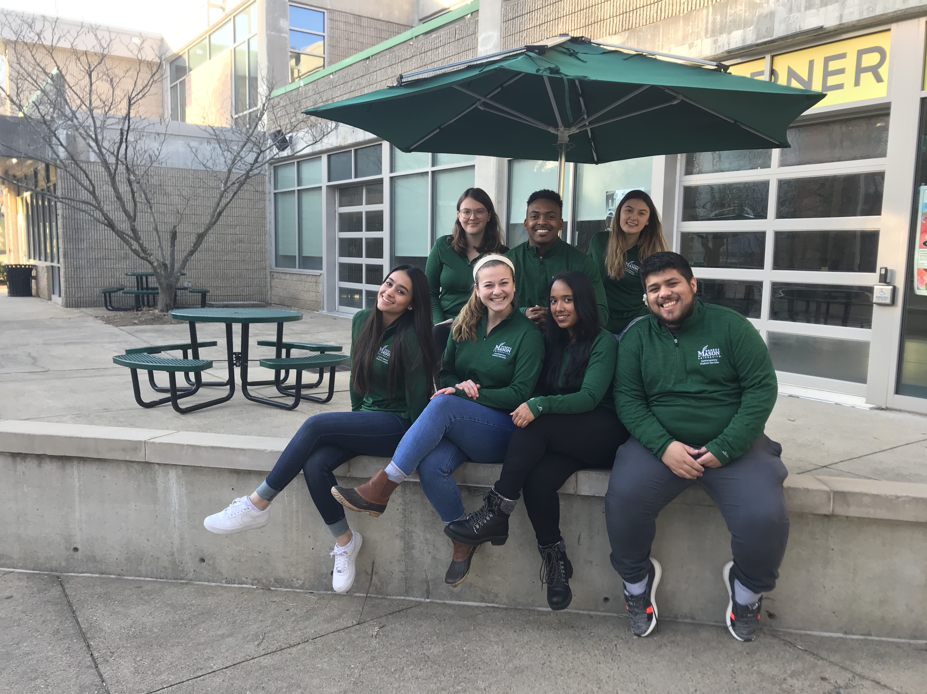
OFF CAMPUS ADVISORS
OFF CAMPUS ADVISORS
They can help you out!
Parking and transportation
Dining
Housing
Academic resources
Social connection
Involvement opportunities
NOT academic advisors, but can help you connect with one!
Off-campus lounge located in the HUB 1014 to hang out, get free coffee, play games, talk to an OCA, etc!

Slide 11
WE CAN’T WAIT TO MEET YOU!
OFFCAMP1@GMU.EDU CONTEMPORARY.GMU.EDU @MASONOFFCAMPUS

